Slide 1
Programmable Logic Devices
CPLD, FPGA
Amit Degada
Asst. Professor
amitdegada@gmail.com
www.amitdegada.weebly.com

Slide 2
Presentation Outline
Introduction
Basics of Progrramble Logic Devices.
CPLDs
FPGA: General Overview
Comperission
Application
Notes:
34
Praxair Semiconductor Manufacturing Technology, Module 3: Semiconductor Manufacturing Processes

Slide 3
Introduction
Development of New types of device called, Field Programmable Devices (FPD) has dramiticallly changed the Digital Design Process.
Advantages: Low Startup Cost, Low Financial Risk, End User Programmable, Easy Design Changes.
FPDs/PLDs Classified into
PROM
PLA
PAL*
Commplex Programmable Logic Device (CPLD)
Field Programmable Gate Array (FPGA)
Notes:
34
Praxair Semiconductor Manufacturing Technology, Module 3: Semiconductor Manufacturing Processes
* PAL is the trademark of Advance Micro Device (AMD)

Slide 4
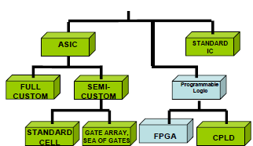
CMOS Design Style
CMOS Design Style
Notes:
34
Praxair Semiconductor Manufacturing Technology, Module 3: Semiconductor Manufacturing Processes

Slide 5
Programmable Logic
Basic Idea: Two Dimensional array of Logic Blocks and Flip-Flops with means for the User to Configure.
Interconnection between the Logic Block
The Function of Each Block
Notes:
34
Praxair Semiconductor Manufacturing Technology, Module 3: Semiconductor Manufacturing Processes

Slide 6
PROM (Probraamable ROM)
The first programmable device – PROM
Programmable OR
Basically available in 2 types viz. One Time Programmable ( OTP ) and field programmable.
The field programmable had 2 types viz. EPROM based and EEPROM based.
Its basic architecture is an input decoder configured from AND gates, combined with a programmable OR matrix on the outputs.
This allows every output to be programmed individually from every possible input combination.
Notes:
34
Praxair Semiconductor Manufacturing Technology, Module 3: Semiconductor Manufacturing Processes

Slide 7
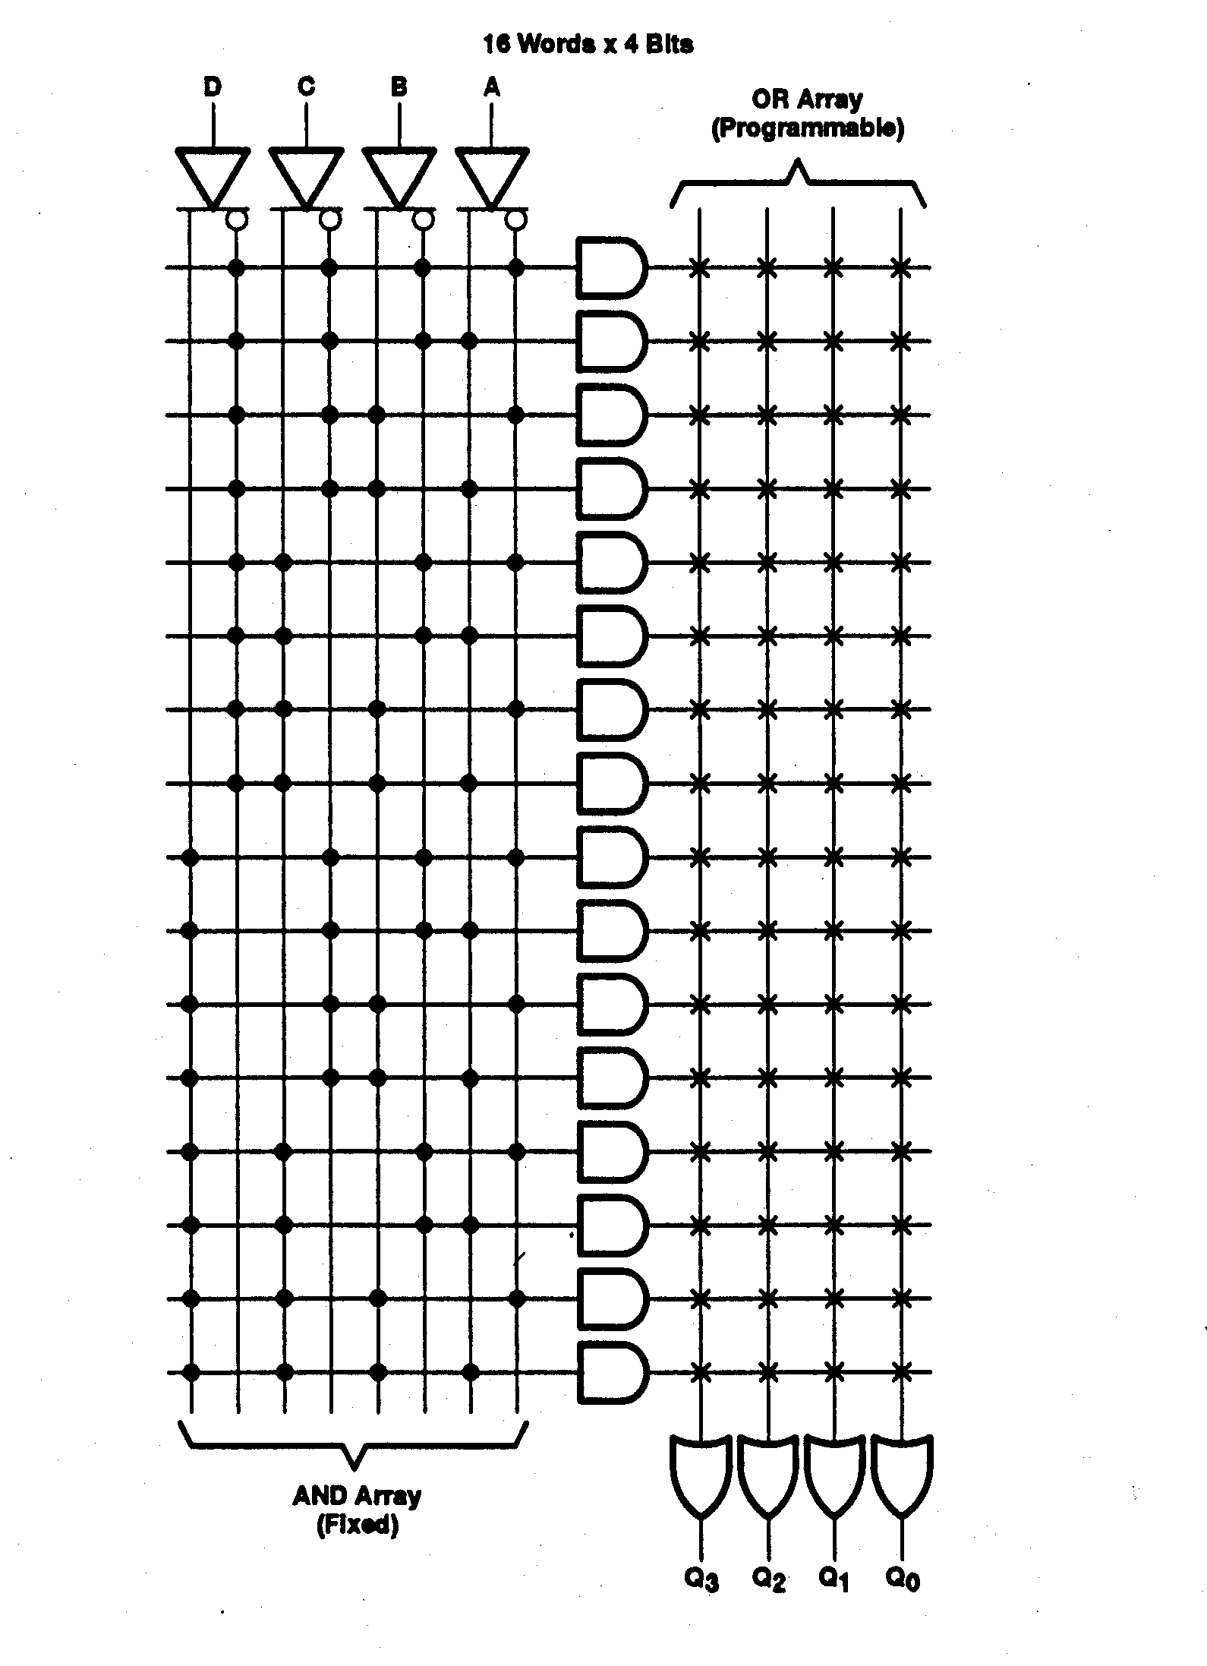
PROM
4 inputs we have 16 combinations and with output width 4, each of the 16X4 bit words can be programmed individually.
Application:
video game consoles
mobile phones
Radio-Frequency identification (RFID) tags
Implantable medical devices
High-Definition Multimedia Interfaces (HDMI) and in
many other consumer and automotive electronics products.
Notes:
34
Praxair Semiconductor Manufacturing Technology, Module 3: Semiconductor Manufacturing Processes

Slide 8
PROM and PLD
Programmed by user in-house by burning out fusible links.
However, PROMs have difficulty accommodating large number of inputs variables. Since each input variable added, the size of fuse matrix doubles.
Overall inefficient architecture for realizing logic circuits.
To overcome the limitation PLD utilizes a slightly different architecture.
Notes:
34
Praxair Semiconductor Manufacturing Technology, Module 3: Semiconductor Manufacturing Processes

Slide 9
PLA (Programmable Logic Array)
First device specially for implementing logic circuits, introduced in the early 1970s by Philips.
Consists of 2 level of logic gates : a programmable “wired” AND-plane followed by a programmable “wired” OR-plane.
Designed to implement random logic expression in SOP form.
Notes:
34
Praxair Semiconductor Manufacturing Technology, Module 3: Semiconductor Manufacturing Processes

Slide 10
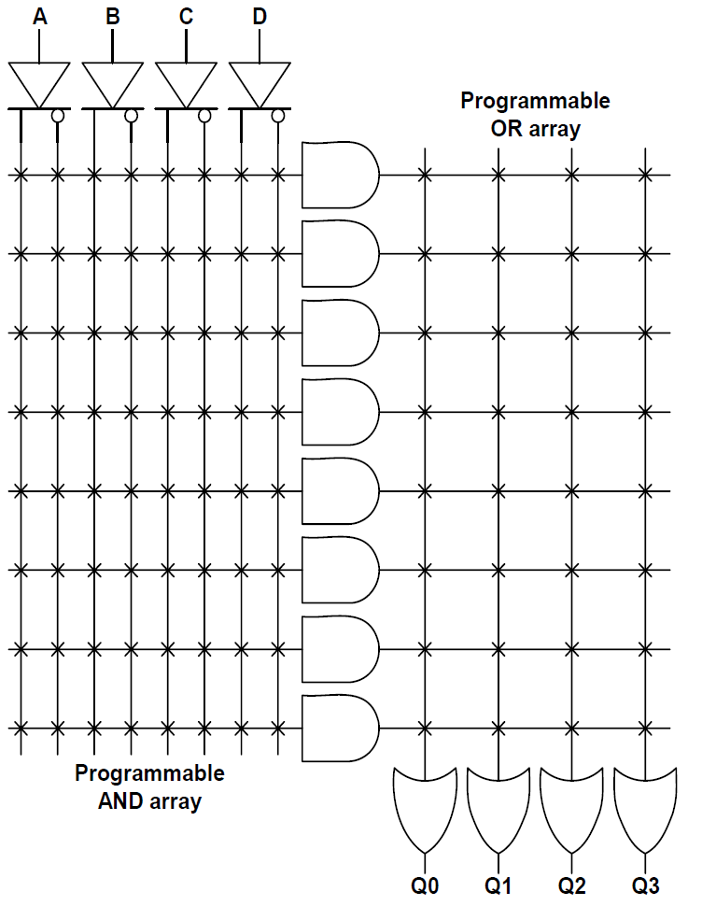
PLA
Sharing of AND terms across multiple Ors
Programmable switches between Horizontal and Verticle Lines
Notes:
34
Praxair Semiconductor Manufacturing Technology, Module 3: Semiconductor Manufacturing Processes

Slide 11
PAL (Programmable Array Logic)
Because of 2 levels of configurable logic PLAs are difficult to manufacture and introduce significant propagation delay.
Solution was PAL.
Notes:
34
Praxair Semiconductor Manufacturing Technology, Module 3: Semiconductor Manufacturing Processes

Slide 12
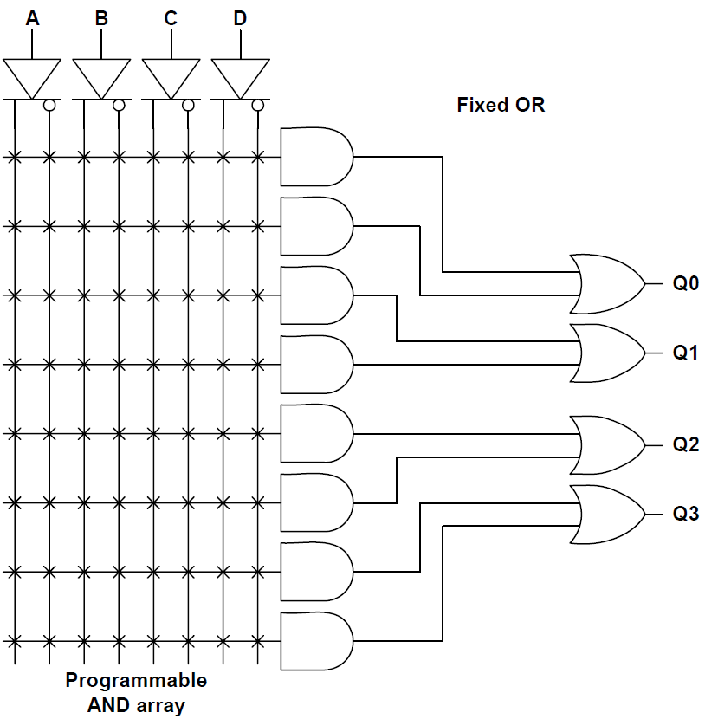
PAL
Finite Combination of AND/Ors
Fewer Switch Count
Faster than PLAs
Notes:
34
Praxair Semiconductor Manufacturing Technology, Module 3: Semiconductor Manufacturing Processes

Slide 13
PAL
Logic is represented in SOP form.
The number of products in a SOP form will be limited to a fixed number.
The number of variables in each product term limited by number of input pins.
The number of independent functions limited by number of output pins.
Notes:
34
Praxair Semiconductor Manufacturing Technology, Module 3: Semiconductor Manufacturing Processes

Slide 14
Evolution of PLDs
As technology has advanced, it has become possible to produce devices with higher capacity.
But, The structure of PALs grow too quickly in size as number of inputs is increased and thus its not possible to produce PAL devices with large capacity.
So integration of multiple PLDs onto a single chip which is called CPLD.
Notes:
34
Praxair Semiconductor Manufacturing Technology, Module 3: Semiconductor Manufacturing Processes

Slide 15
CPLD ( Complex PLD)
CPLDs were an evolutionary step from even smaller devices that preceded them
CPLDs can be thought of as multiple PLDs (plus some programmable interconnect) in a single chip.
The larger size of a CPLD allows you to implement either more logic equations or a more complicated design.
Because CPLDs can hold larger designs than PLDs, their potential uses are more varied.
Notes:
34
Praxair Semiconductor Manufacturing Technology, Module 3: Semiconductor Manufacturing Processes

Slide 16
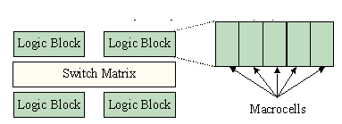
CPLD
logic blocks are themselves comprised of macrocells and interconnect wiring, just like an ordinary PLD.
Unlike the programmable interconnect within a PLD, the switch matrix within a CPLD may or may not be fully connected.
The effect of this is most often to make 100% utilization of the macrocells very difficult to achieve.
Notes:
34
Praxair Semiconductor Manufacturing Technology, Module 3: Semiconductor Manufacturing Processes

Slide 17
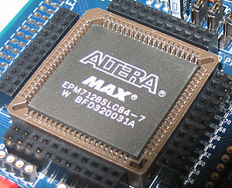
CPLD
Traditionally, CPLDs have been chosen over FPGAs whenever high-performance logic is required, Because of its less flexible internal architecture, the delay is more predictable and usually shorter.
Notes:
34
Praxair Semiconductor Manufacturing Technology, Module 3: Semiconductor Manufacturing Processes

Slide 18
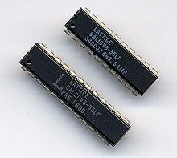
GALs (Generic Array Logic)
An innovation of the PAL was the generic array logic device, or GAL, invented by Lattice Semiconductor in 1985.
This device has the same logical properties as the PAL but can be erased and reprogrammed.
Programmed by PAL programmer but can be erased and reprogrammed.
A similar device called a PEEL (programmable electrically erasable logic) was introduced by the International CMOS Technology (ICT) corporation.
Notes:
34
Praxair Semiconductor Manufacturing Technology, Module 3: Semiconductor Manufacturing Processes

Slide 19
Field Programmable Gate Array
The Field-Programmable Gate Arrays (FPGAs) provide the benefits of custom CMOS VLSI, while avoiding the initial cost, time delay.
FPGA consists of basically an array of logic blocks and routing channels.
The FPGA has three major configurable elements: configurable logic blocks (CLBs), input/output blocks, and interconnects.
Notes:
34
Praxair Semiconductor Manufacturing Technology, Module 3: Semiconductor Manufacturing Processes

Slide 20
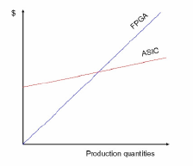
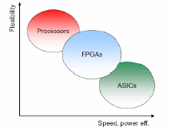
Field Programmable Gate Array
ASIC gives high performance at cost of inflexibility.
Processor is very flexible but not tuned to the application.
Reconfigurable hardware is a nicecompromise
Notes:
34
Praxair Semiconductor Manufacturing Technology, Module 3: Semiconductor Manufacturing Processes

Slide 21
Meaning of ‘Field Programmable’
Field Programmable means that the FPGA's function is defined by a user's program rather than by the manufacturer of the device.
A typical integrated circuit performs a particular function defined at the time of manufacture.
In contrast, the FPGA's function is defined by a program written by someone other than the device manufacturer.
Depending on the particular device, the program is either 'burned' in permanently or semi-permanently as part of a board assembly process, or is loaded from an external memory each time the device is powered up.
Notes:
34
Praxair Semiconductor Manufacturing Technology, Module 3: Semiconductor Manufacturing Processes

Slide 22
How are FPGA programs created?
Individually defining the many switch connections and cell logic functions would be a daunting task.
Fortunately, this task is handled by special software.
The software translates a user's schematic diagrams or textual hardware description language code then places and routes the translated design.
Most of the software packages have hooks to allow the user to influence implementation, placement and routing to obtain better performance and utilization of the device.
Libraries of more complex function macros (eg. adders) further simplify the design process by providing common circuits that are already optimized for speed or area.
Notes:
34
Praxair Semiconductor Manufacturing Technology, Module 3: Semiconductor Manufacturing Processes

Slide 23
Logic design Process
Notes:
34
Praxair Semiconductor Manufacturing Technology, Module 3: Semiconductor Manufacturing Processes

Slide 24
FPGA Basics
The FPGAs are customized by loading configuration data into the internal memory cells.
Based on placement of logic blocks FPGA’s are classified into 4 categories viz. symmetrical array, row-based, hierarchical PLD, and sea-of-gates
Notes:
34
Praxair Semiconductor Manufacturing Technology, Module 3: Semiconductor Manufacturing Processes

Slide 25
FPGA Basics
Notes:
34
Praxair Semiconductor Manufacturing Technology, Module 3: Semiconductor Manufacturing Processes

Slide 26
FPGA Architecture
Configure Logic Blocks (CLB)
Input/ Output Blocks IOBs
Interconnects
Notes:
34
Praxair Semiconductor Manufacturing Technology, Module 3: Semiconductor Manufacturing Processes

Slide 27
Logic Cell
The logic cell architecture varies between different device families.
Each logic cell combines a few binary inputs (typically between 3 and 10) to one or two outputs according to a boolean logic function specified in the user program .
The cell's combinatorial logic may be physically implemented as a small look-up table memory (LUT) or as a set of multiplexers and gates.
LUT devices tend to be a bit more flexible and provide more inputs per cell than multiplexer cells at the expense of propagation delay.
Notes:
34
Praxair Semiconductor Manufacturing Technology, Module 3: Semiconductor Manufacturing Processes

Slide 28
CLB
In general, a logic block (CLB) consists of a few logical cells.
A typical cell consists of a 4-input Lookup table (LUT), a Full adder (FA) and a D-type flip-flop
In normal mode those are combined into a 4-input LUT through the left mux.
In arithmetic mode, their(LUT) outputs are fed to the FA. The selection of mode are programmed into the middle mux. The output can be either synchronous or asynchronous, depending on the programming of the mux to the right, in the figure example.
Notes:
34
Praxair Semiconductor Manufacturing Technology, Module 3: Semiconductor Manufacturing Processes

Slide 29
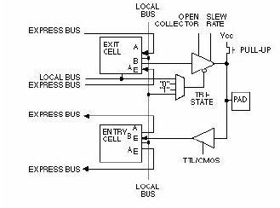
IOBs
Notes:
34
Praxair Semiconductor Manufacturing Technology, Module 3: Semiconductor Manufacturing Processes

Slide 30
Interconnects
Generally, the FPGA routing is unsegmented. That is, each wiring segment spans only one logic block before it terminates in a switch box.
By turning on some of the programmable switches within a switch box, longer paths can be constructed.
For higher speed interconnect, some FPGA architectures use longer routing lines that span multiple logic blocks.
Notes:
34
Praxair Semiconductor Manufacturing Technology, Module 3: Semiconductor Manufacturing Processes

Slide 31
Interconnects
Whenever a vertical and a horizontal channel intersect, there is a switch box.
The pattern, or topology, of switches used in this architecture is the planar or domain-based switch box topology. In this switch box topology, a wire in track number one connects only to wires in track number one in adjacent channel segments, wires in track number 2 connect only to other wires in track number 2 and so on…………….
Notes:
34
Praxair Semiconductor Manufacturing Technology, Module 3: Semiconductor Manufacturing Processes

Slide 32
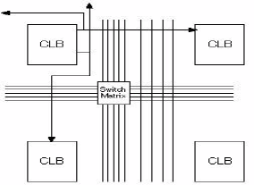
Interconnects
More detailed View
Notes:
34
Praxair Semiconductor Manufacturing Technology, Module 3: Semiconductor Manufacturing Processes

Slide 33
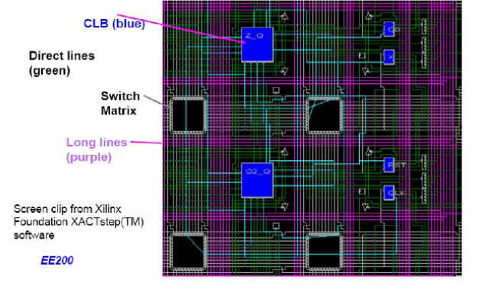
Detailed ViewInterconnects
More detailed View
Notes:
34
Praxair Semiconductor Manufacturing Technology, Module 3: Semiconductor Manufacturing Processes

Slide 34
FPGA Technology
Based on the technology used for the routing of the logic blocks FPGA are divided into 4 classes.
They are viz. Static RAM based, Antifuse based, EPROM based and FLASH based.
Re-programmability, Speed, Density, Cost depends on the technology used in the FPGA.
Notes:
34
Praxair Semiconductor Manufacturing Technology, Module 3: Semiconductor Manufacturing Processes

Slide 35
Static RAM Technology
In the Static RAM FPGA programmable connections are made using pass transistors, transmission gates, or multiplexers that are controlled by SRAM cells.
The main feature of this technology is that it allows fast in-circuit reconfiguration.
The FPGA can either actively read its configuration data out of external serial or byte-parallel PROM or the configuration data can be written into the FPGA.
The FPGA can be programmed an unlimited number of times and supports system clock rates of up to 100 MHz
Notes:
34
Praxair Semiconductor Manufacturing Technology, Module 3: Semiconductor Manufacturing Processes

Slide 36
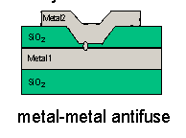
Anti-Fuse Technology
An anti-fuse resides in a high-impedance state; and can be programmed into low impedance or "fused" state.
Notes:
34
Praxair Semiconductor Manufacturing Technology, Module 3: Semiconductor Manufacturing Processes

Slide 37
Anti-Fuse Technology
The link is created by melting the thin isolating dielectric between 2 metal layers.
Only few links needed to be programmed.
( e.g. 2% - 4% in a FPGA)
A less expensive than the RAM technology, this device is a program once device.
Notes:
34
Praxair Semiconductor Manufacturing Technology, Module 3: Semiconductor Manufacturing Processes

Slide 38
Advantages of Reconfiguration
The hardware can changed as easily as software.
Design updates are easy, can be made to product already on field.
Can be reconfigured dynamically to perform different function at different times. Multipurpose hardware.
Simplifies hardware design and debugging. Reduce time to market.
Notes:
34
Praxair Semiconductor Manufacturing Technology, Module 3: Semiconductor Manufacturing Processes

Slide 39
Disadvantages of Reconfiguration
The programmability causes reduction in speed.
Require more silicon. Less amount of logic in a given area.
Costly.
Notes:
34
Praxair Semiconductor Manufacturing Technology, Module 3: Semiconductor Manufacturing Processes

Slide 40
Selecting FPGA
Gate Count
Number of I/O Pins
Cost per chip
Available Tools
Performance
Power Consumption
Packaging
Notes:
34
Praxair Semiconductor Manufacturing Technology, Module 3: Semiconductor Manufacturing Processes

Slide 41
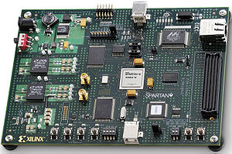
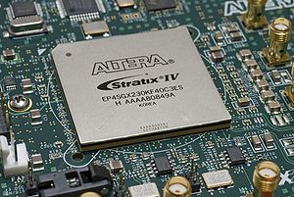
FPGA Boards
Xilink and Altera are laeding manufacturer.
Notes:
34
Praxair Semiconductor Manufacturing Technology, Module 3: Semiconductor Manufacturing Processes

Slide 42
FPGA Vs CPLD
Notes:
34
Praxair Semiconductor Manufacturing Technology, Module 3: Semiconductor Manufacturing Processes

Slide 43
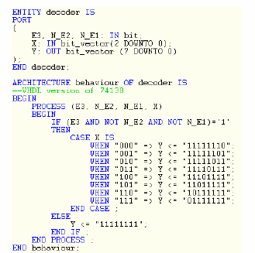
How Do you Program CPLD FPGA?
Schematic Entry
Hardware Description Lang
VHDL
Verylog HDL
Notes:
34
Praxair Semiconductor Manufacturing Technology, Module 3: Semiconductor Manufacturing Processes

Slide 44
Thanks
Give Your Feedbacks at:
www.amitdegada.weebly.com/blog.html
Notes:
34
Praxair Semiconductor Manufacturing Technology, Module 3: Semiconductor Manufacturing Processes

Slide 45
Notes:
34
Praxair Semiconductor Manufacturing Technology, Module 3: Semiconductor Manufacturing Processes

Slide 46
Notes:
34
Praxair Semiconductor Manufacturing Technology, Module 3: Semiconductor Manufacturing Processes

